Slide 1
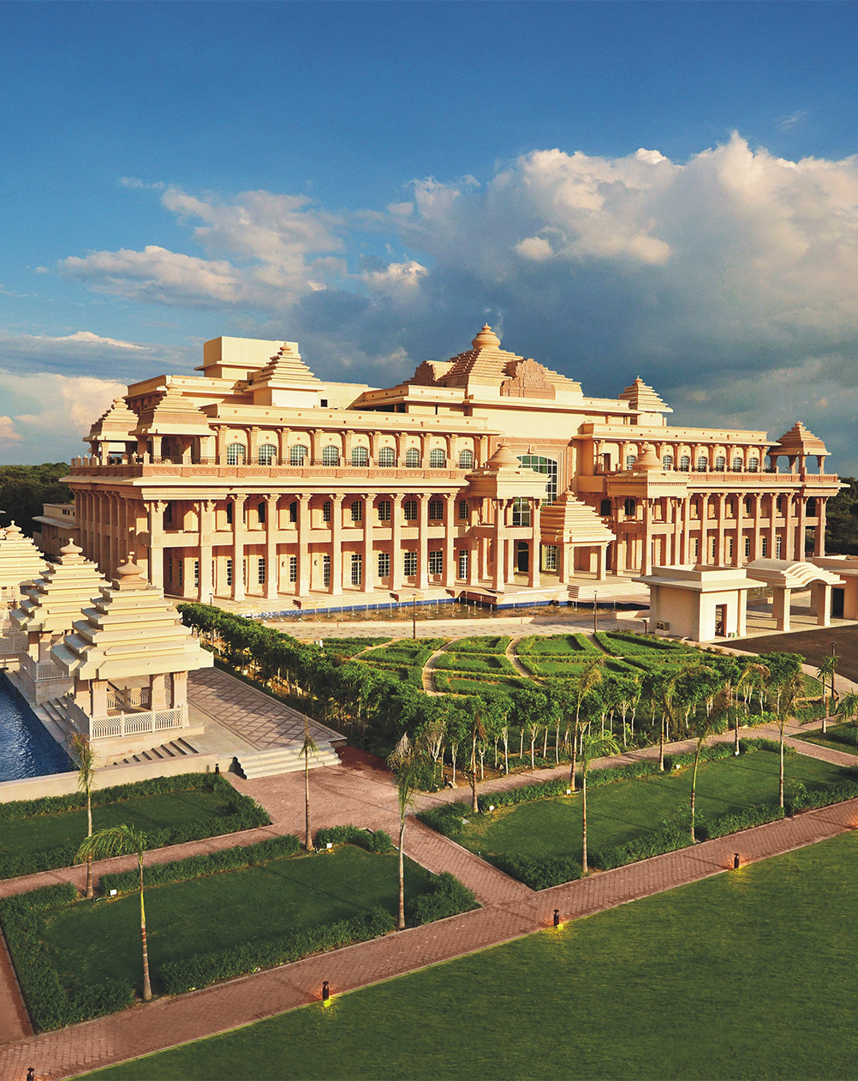

ITC HOTELS
ITC Hotels Business Performance Analysis
Submitted By:-Md Pravez Alam

Slide 2

ITC
ITC was established on August 24, 1910
Indian public conglomerate company headquartered in Kolkata, West Bengal, India
ITC's annual turnover stood at $7 billion and market capitalization of over $34 billion
The company is currently headed by Yogesh Chander Deveshwar (CEO)
It employs over 29,000 people at more than 60 locations across India and is listed on Forbes 2000
ITC Limited completed 100 years on 24th August 2010

Slide 3
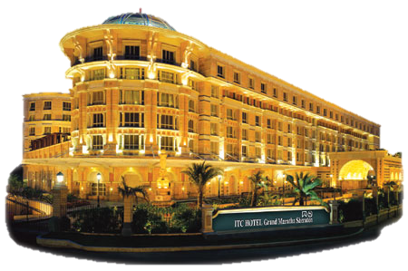

ITC entered the hotel industry in 1975
Company Logo
ITC’s extension in Luxury Hotels

Slide 4
BRANDING
ITC Hotels presents the GREENEST LUXURY HOTEL CHAIN in the WORLD.
Tagline – “RESPONSIBILITY LUXURY”
ITC Hotels is an exemplar in sustainable hospitality with all its premium hotels being LEED® Platinum certified
The group today operates under FOUR distinct brands:
Luxury Collection Hotels
Sheraton Hotels
Fortune Hotels
Welcome heritage hotel

Slide 5
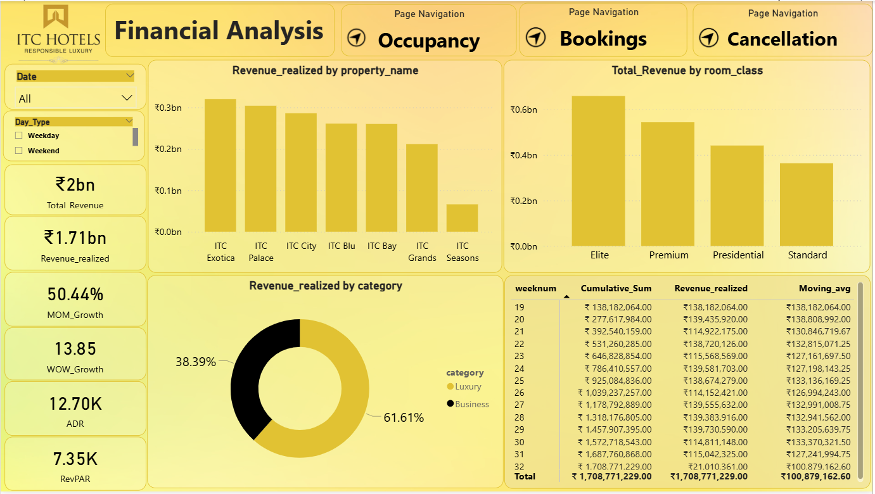
Dashboard Focus: Financial Performance Overview This dashboard exclusively analyzes the financial performance of ITC Hotels between May 1, 2022 – July 31, 2022, covering key metrics like revenue, growth rates, revenue by property and room class, and weekly trends.

Slide 6
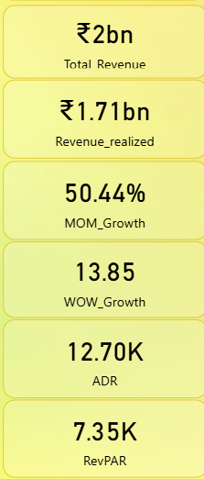
Card | Value | Explanation
Total Revenue | ₹2.01bn | Gross income generated from all bookings, regardless of cancellations or payment issues.
Revenue Realized | ₹1.71bn | Actual cash inflow after accounting for cancellations, discounts, or pending payments.
MoM Growth | 50.44% | Indicates a strong Month-over-Month increase in realized revenue.
WoW Growth | 13.85 | Reflects Week-over-Week growth; positive momentum in recent weeks.
ADR (Average Daily Rate) | ₹12.70K | Average income per booked room per day – reflects pricing strategy strength.
RevPAR (Revenue per Available Room) | ₹7.35K | Revenue per room (regardless of whether booked or not); lower than ADR, showing capacity for improving occupancy.

Slide 7
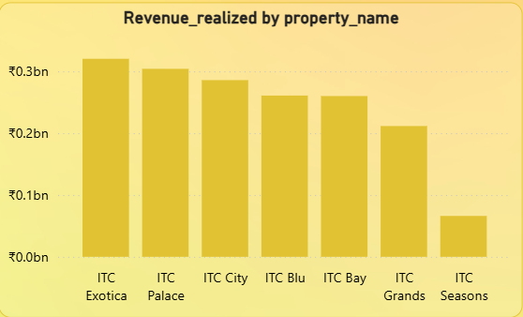
🔷 Charts Analysis
Revenue Realized by Property Name
What it shows: Financial contribution of each hotel property. Top Performers: ITC Exotica ITC Palace ITC City Lowest: ITC Seasons – significantly underperforming. Actionable Insight: Focus improvement efforts (pricing, marketing, operations) on ITC Seasons. Learn from ITC Exotica's and Palace's strategies to replicate across weaker properties.

Slide 8
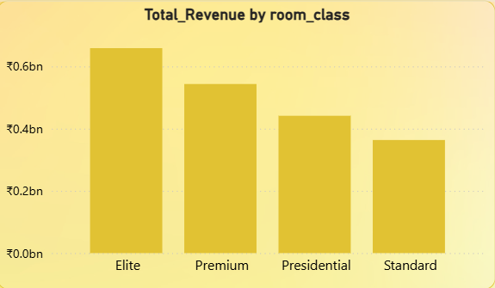
What it shows: Financial contribution by room type. Top Contributor: Elite class. Lowest: Standard rooms. Insight & Recommendation: Elite and Premium classes drive luxury revenue; ensure continued high-quality service. Consider rebranding or value-adding to Standard rooms to raise their revenue share.
Total Revenue by Room Class

Slide 9
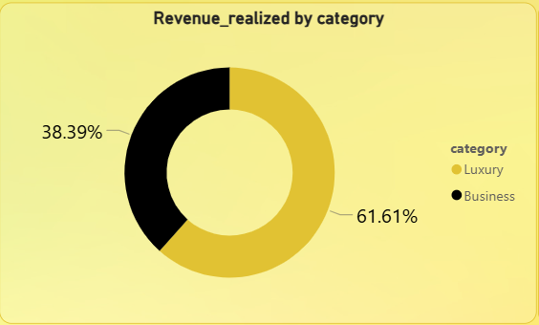
Revenue Realized by Category (Luxury vs Business)
Luxury: 61.61%
Business: 38.39%
Insight: ITC Hotels is clearly positioned toward the luxury segment, which dominates the revenue.
Recommendation
Maintain strong luxury branding and pricing.
Explore potential in the Business category (e.g., corporate partnerships, events, long-stays).

Slide 10
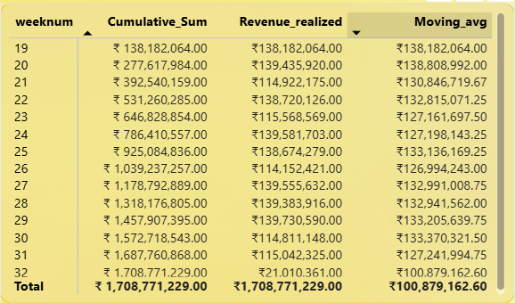
Column | Meaning
weeknum | Week number in the selected date range.
Cumulative_Sum | Running total of realized revenue.
Revenue_realized | Revenue generated that week.
Moving_avg | Smoothed average across weeks – helps in trend detection.

Slide 11
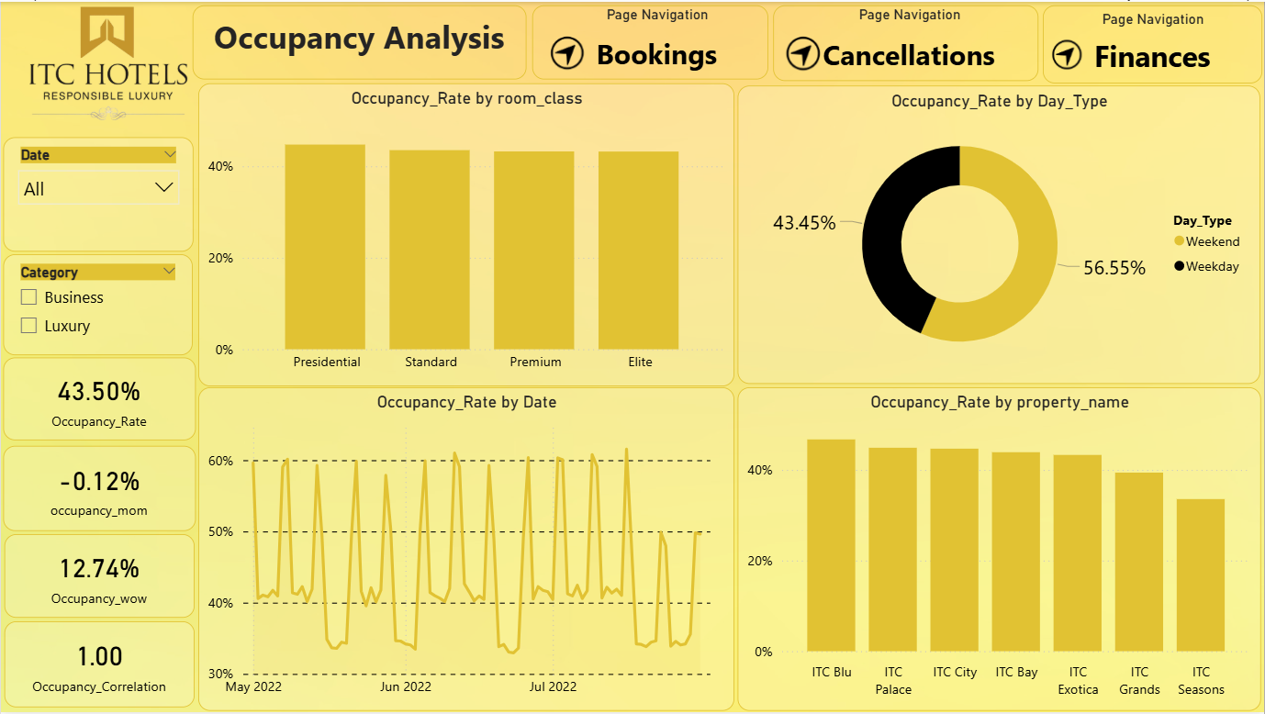
🟨 Dashboard Focus: Occupancy Analysis This dashboard provides a deep dive into the occupancy performance of ITC Hotels from May to July 2022. It highlights the occupancy rate trends across room classes, properties, dates, and day types. The goal is to help optimize room usage, improve operational efficiency, and maximize revenue per room.

Slide 12
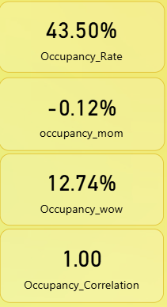
Card | Metric | Explanation
Occupancy Rate | 43.50% | Overall hotel occupancy across all properties and dates – this is low for a premium brand, room to improve.
Occupancy MoM | -0.12% | Slight decline Month-over-Month indicates stagnation or missed opportunity.
Occupancy WoW | 12.74% | Positive weekly growth – showing short-term improvement.
Occupancy Correlation | 1.00 | Perfect positive correlation between key factors and occupancy (e.g., pricing, seasonality) – indicates good model fit or strong influencing trends.

Slide 13
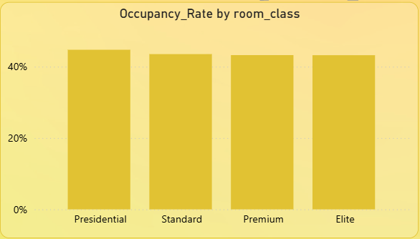
🔷 Charts Analysis
Occupancy Rate by Room Class
Insight: All room classes (Presidential, Standard, Premium, Elite) have nearly equal occupancy around 43–44%.
Recommendation:
Despite price differences, all room types are equally preferred – good sign.
Consider differential promotions to increase higher-margin room occupancy (Presidential & Elite).

Slide 14
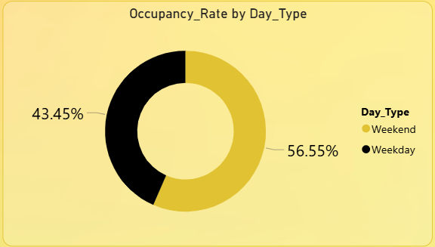
Occupancy Rate by Day Type
Weekdays (56.55%) have higher occupancy than Weekends (43.45%).
Insight:
Indicates ITC Hotels may serve a larger business clientele.
Recommendation:
Increase weekend-focused offers/packages (spa deals, staycations) to balance demand.
Target families and leisure travelers via weekend-specific campaigns.

Slide 15
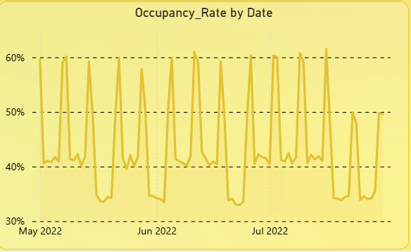
3
Occupancy Rate by Date (Time Series)
Shows high daily volatility – occupancy fluctuates between 30%–60%.
Insight:
Regular peaks suggest weekend/weekday cycles.
Some weeks show sharp dips, possibly due to events, holidays, or operational issues.
Recommendation:
Analyze low-performing dates to determine causes (cancellations, external events).
Use predictive modeling to anticipate dips and offer dynamic pricing.

Slide 16
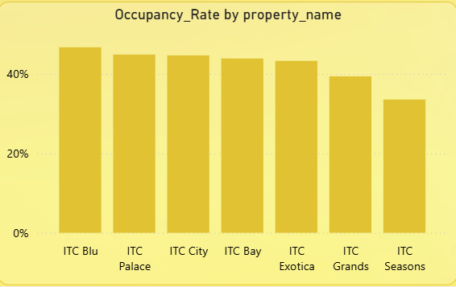
Occupancy Rate by Property Name
Top Performers:
ITC Blu, Palace, City – all above 45%.
Underperformers:
ITC Grands and ITC Seasons (lowest).
Insight:
Property-specific issues may exist (location, service, pricing).
Recommendation:
Conduct audits for low-performing properties.
Use best practices from ITC Blu and City for replication.

Slide 17
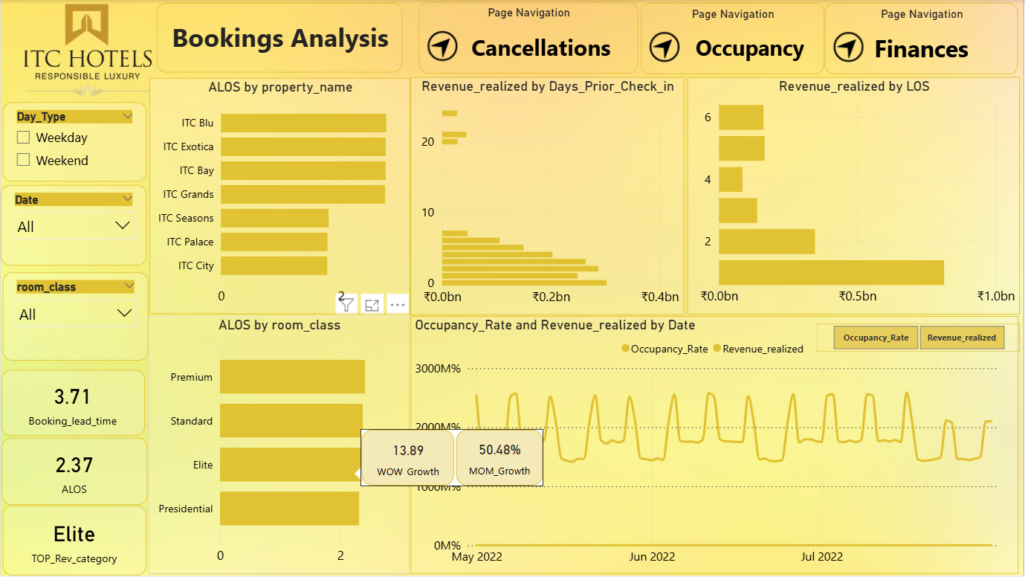
🟨 Dashboard Focus: Bookings Analysis This dashboard analyzes booking behavior and revenue patterns at ITC Hotels. It emphasizes when, how, and for how long guests book, and how this impacts revenue. The focus is on ALOS (Average Length of Stay), booking lead time, and revenue realized — tracked across room categories, hotel properties, and guest behavior trends.

Slide 18
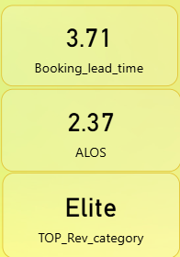
Metric | Value | Meaning
Booking Lead Time | 3.71 days | Guests are typically booking 3–4 days before arrival, indicating short-notice bookings.
ALOS (Average Length of Stay) | 2.37 days | Guests stay on average ~2.4 days — consistent with short-term business or weekend leisure stays.
Top Revenue Category | Elite | Bookings in Elite rooms generate the highest revenue. This segment is key for financial growth.

Slide 19
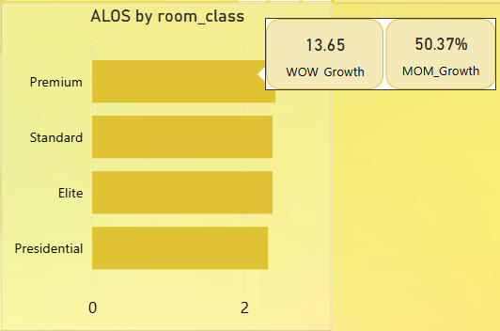
Parameter | Value | Interpretation
WOW Growth (Week-over-Week ALOS) | 13.65% ↑ | Weekly length of stay is improving — a good sign of customer engagement or success of long-stay offers.
MOM Growth (Month-over-Month ALOS) | 50.37% ↑ | Monthly ALOS has grown significantly — this could be driven by peak season, extended stays, or corporate tie-ups.
✅ Insight: Hotel booking trends show increasing stay durations, which enhances revenue per guest.

Slide 20
🔷 Visual Insights
ALOS by Room Class Premium rooms show highest average stay duration, followed by Standard, Elite, and Presidential. Insight: Guests prefer staying longer in Premium rooms, possibly due to comfort and value balance. Action: Promote long-stay offers with Premium and Standard rooms.

Slide 21
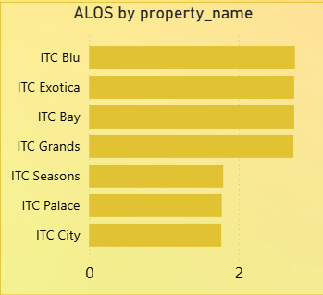
. ALOS by Property
ITC Blu, Exotica, and Bay lead in average guest stay duration.
ITC City and Seasons show shorter stays.
Insight: Properties with high ALOS likely serve business/leisure travelers with bundled services.
Action: Analyze guest profiles at high-performing properties and replicate strategies at others.

Slide 22
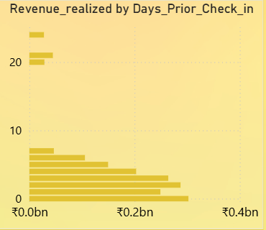
Revenue Realized by Days Prior to Check-in
Most revenue is generated from bookings made closer to the check-in date (1–4 days prior).
Insight: Last-minute bookings are a key behavior pattern.
Action: Introduce “early bird” discounts to drive advance bookings and stabilize revenue forecast.

Slide 23
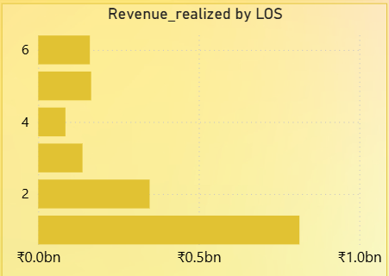
Revenue Realized by LOS (Length of Stay)
Highest revenue comes from guests staying 1–2 nights.
Steep drop in revenue for stays beyond 3 nights.
Insight: Most guests prefer short stays.
Action: Offer attractive pricing or loyalty incentives for 3+ night bookings to improve long-stay revenue

Slide 24
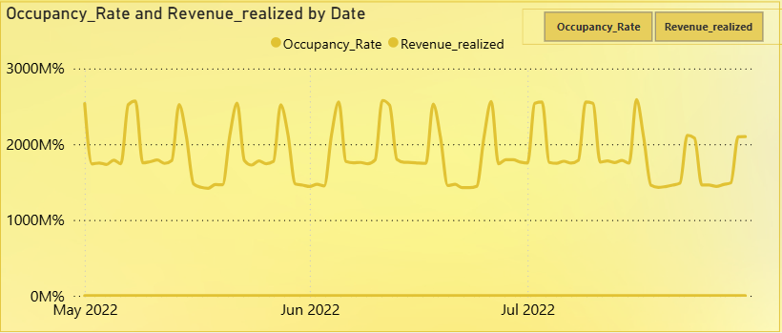
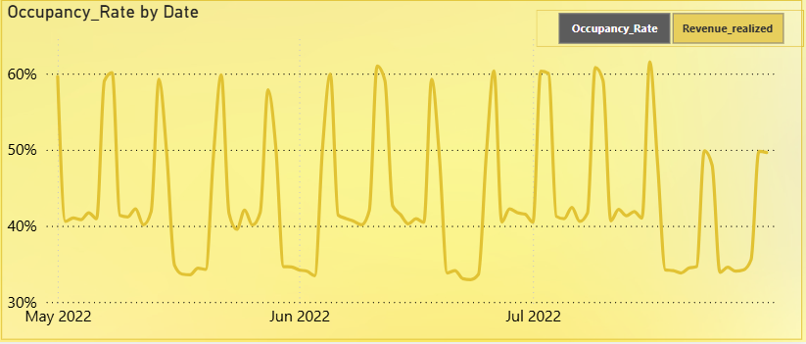
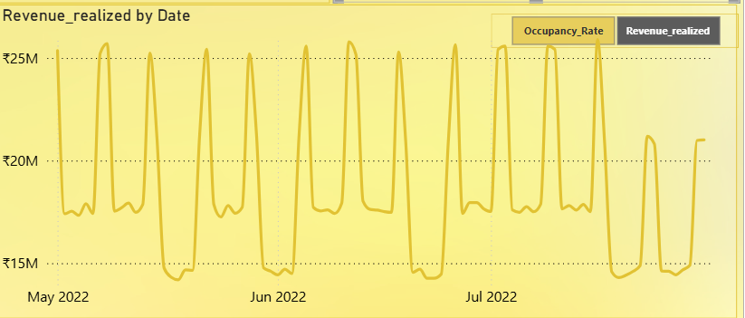
Time-Series: Occupancy Rate vs Revenue Realized
Shows how booking patterns affect occupancy and earnings over time (May to July 2022).
Regular spikes (likely weekends or special dates) show occupancy and revenue rising together.
Insight: There's a strong correlation between booking trends and revenue cycles.
Action: Plan promotions aligned with these peak cycles to maximize yield.

Slide 25
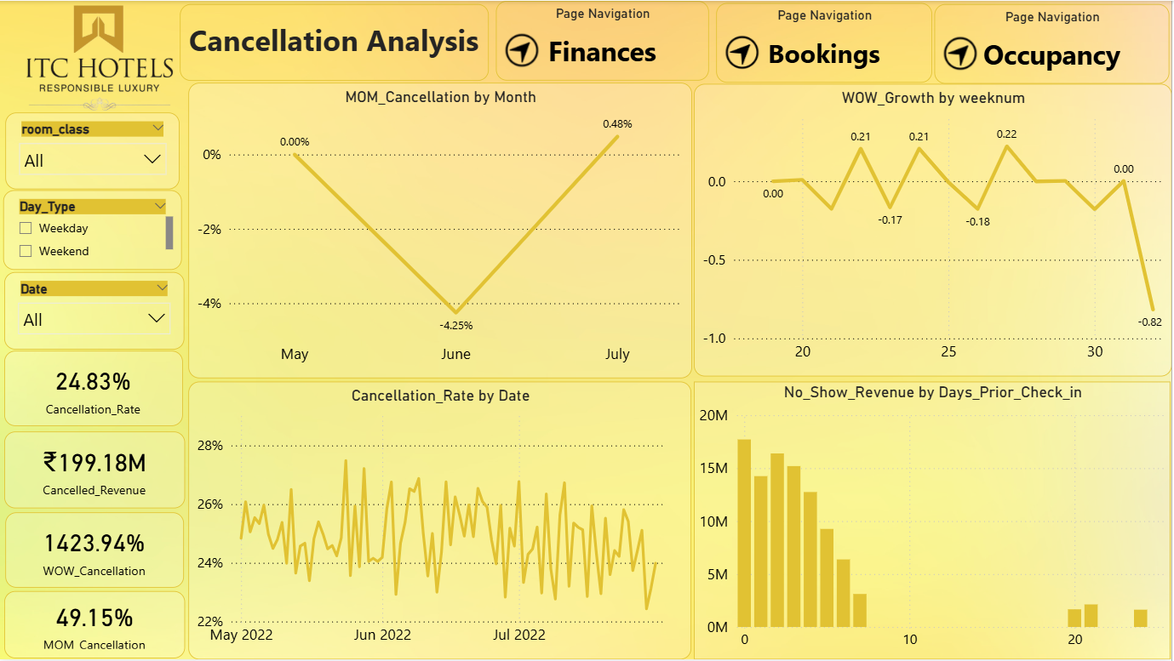
🟨 Dashboard Focus: Booking Cancellations Analysis This dashboard examines booking cancellations at ITC Hotels, analyzing trends, rates, financial impact, and guest behavior around cancellations and no-shows.

Slide 26
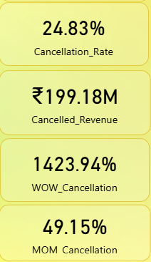
Metric | Value | Insight
Cancellation Rate | 24.83% | Nearly 1 in 4 bookings gets canceled — this is very high and should be addressed.
Cancelled Revenue | ₹199.18M | Loss of ₹199 million due to cancellations — a massive financial impact.
WOW_Cancellation | 1423.94% ↑ | Huge spike in weekly cancellations, possibly due to a policy change, seasonality, or external factors.
MOM_Cancellation | 49.15% ↑ | Cancellations also rose sharply month-over-month — shows a trend, not just a one-time spike.

Slide 27
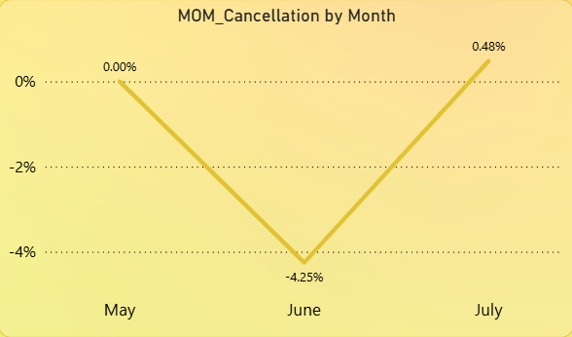
🔷 Detailed Analysis
1. MOM_Cancellation by Month
June saw the lowest cancellations (-4.25%), but July spiked again with +0.48%.
May was neutral.
Insight: Something in July triggered more cancellations — maybe weather, service issue, or pricing confusion.
Action: Compare July's policies or marketing campaigns to identify anomalies.

Slide 28
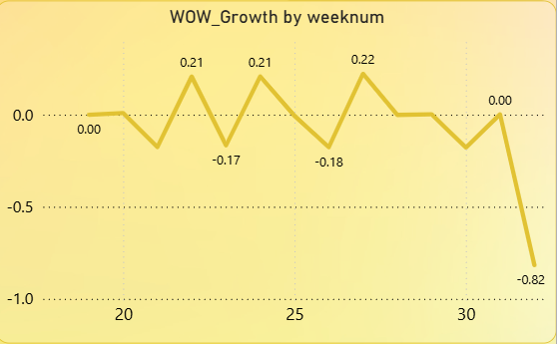
WOW_Growth by Week Number
Weeks 21–26 show small positive growth (~0.2%), but by week 31, cancellation growth plummets to -0.82.
Insight: After steady weeks, there’s a sudden drop, likely due to a correction or policy update.
Action: Maintain measures that led to decline after week 30.

Slide 29
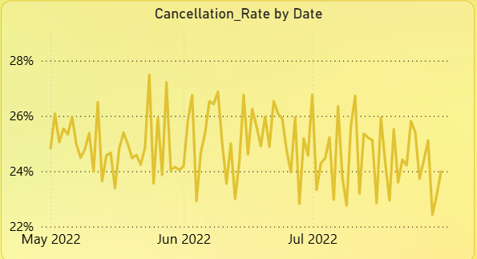
Cancellation Rate by Date (Time Series)
Cancellation rate fluctuates between 23% and 27% daily.
Slight increase mid-June and stable until end-July.
Insight: The issue is not random; cancellations are a daily occurrence, not one-off spikes.
Action: A deeper look into daily booking sources (e.g., OTAs, direct, travel agents) may reveal root causes.

Slide 30
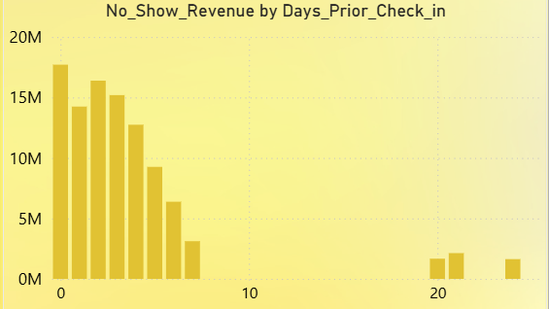
No-Show Revenue by Days_Prior_Check_in
Most no-show losses occur when guests book 0–5 days before check-in.
Insight: Last-minute bookings lead to maximum revenue loss due to no-shows.
Action: Implement stricter cancellation/no-show fees for short-window bookings, or require deposits.

Slide 31

Place
Strategic Locations
Metropolitan cities
Business hubs
Tourist places
Heritage areas
Mumbai
Bengaluru
Kolkata
Agra
Aurangabad
Chennai
Hyderabad
Jaipur
Vadodara
Delhi
ITC is spread across various cities in India

Slide 32



PROMOTIONS
Loyalty Program for Customers
Tie up with Wills Lifestyle stores
Schemes based on Usage
1
2
3
ITC has a reward program for its customers
Members will earn loyalty points based on usage
ITC has a tie up with Wills Lifestyle
Members get rewarded with Loyalty points for their purchase
ITC offers various schemes to increase consumption (one night stay free in the hotel for spending Rs. 60,000 in its properties)

Slide 33
SEGMENTATION
“Grouping people according to their similarity related to a particular product category.”
Geographical – Urban Area
Demographical – High Income people, based on age – 30+
Psychographic – Life style
FEEL GOOD – Hospitality and ambiance

Slide 34
TARGETING
High Income Families.
Couples both Indians and foreigners.
Business travellers.
Corporate – Meeting & Events

Slide 35
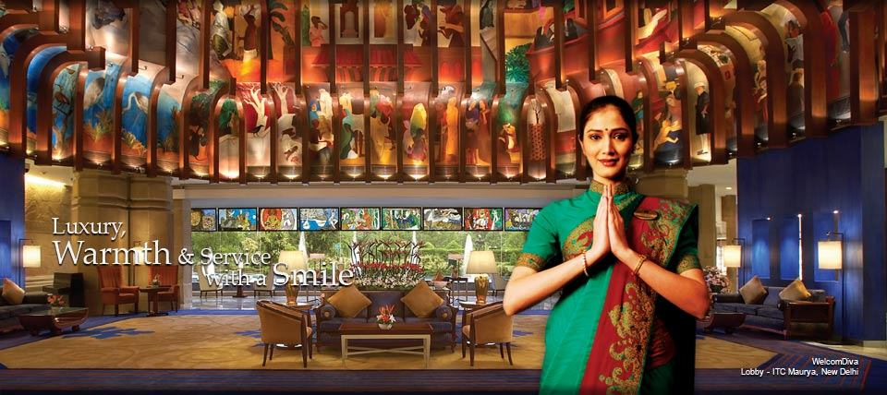
POSITIONING
Tag line – “Responsibility Luxury”

Slide 36
THANKYOU

